Slide 1
CyberMiner
Collin Matz
Fredrick Horn
Parker Tate
Conner Carraher
Joshua Brown
Pranit Konda
Jacob Danel
Team website: https://cs4376-team-a.github.io/Project/

Slide 2
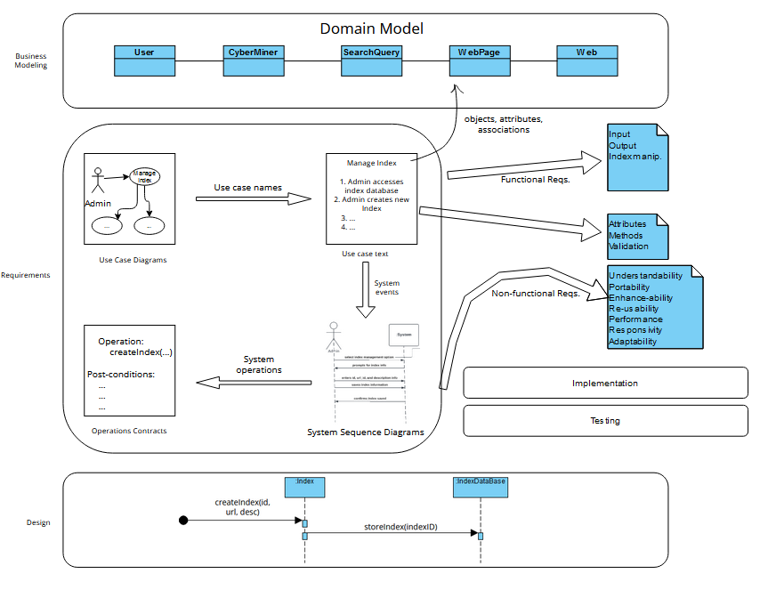
General Overview

Slide 3
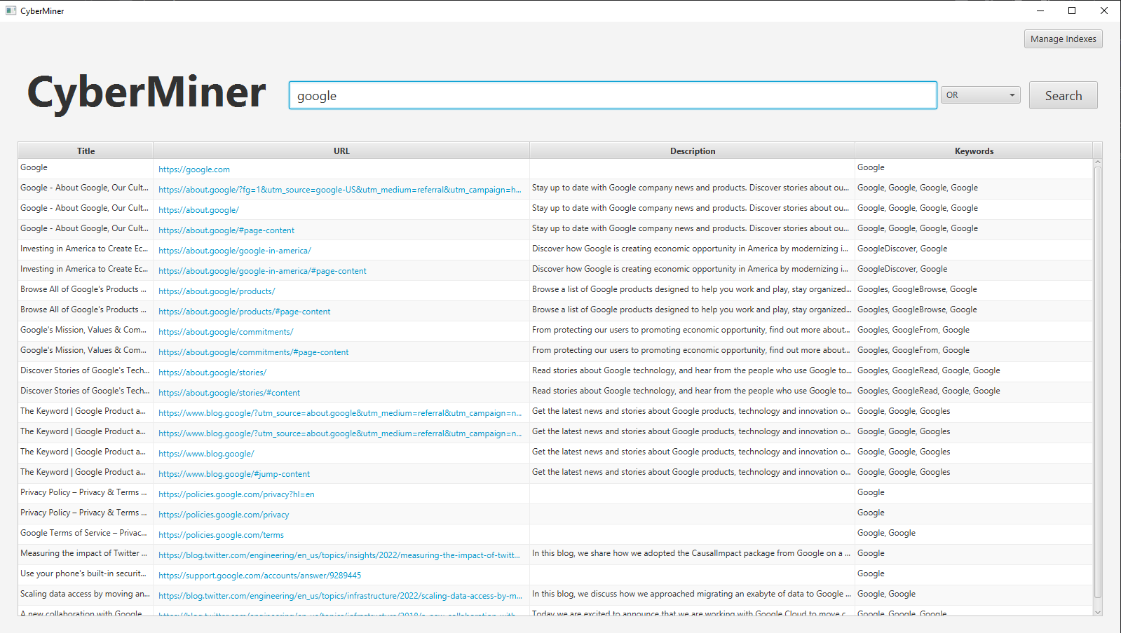
Demo

Slide 4
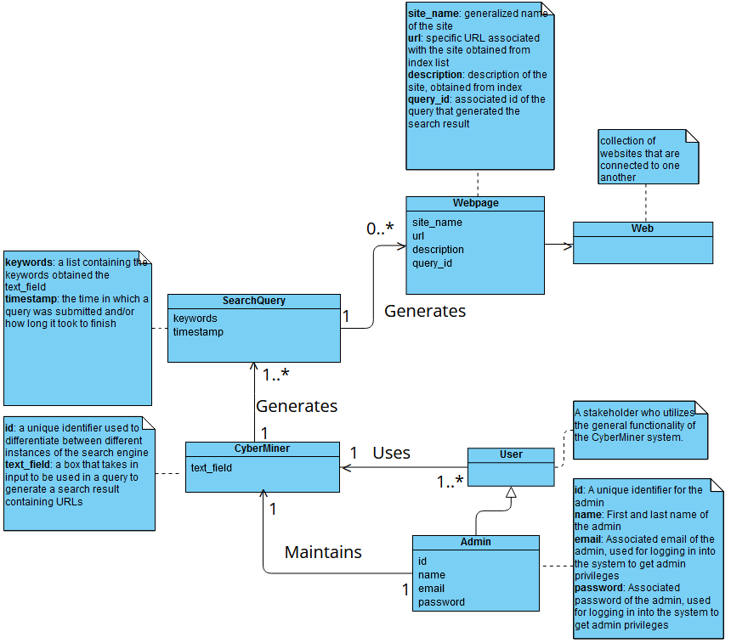
Domain Model
General layout of the system
Sequence of events?
Slight variations from phase 1
user is more generic now, no stored information
Admin must login to do their work
Rest of system mostly the same

Slide 5
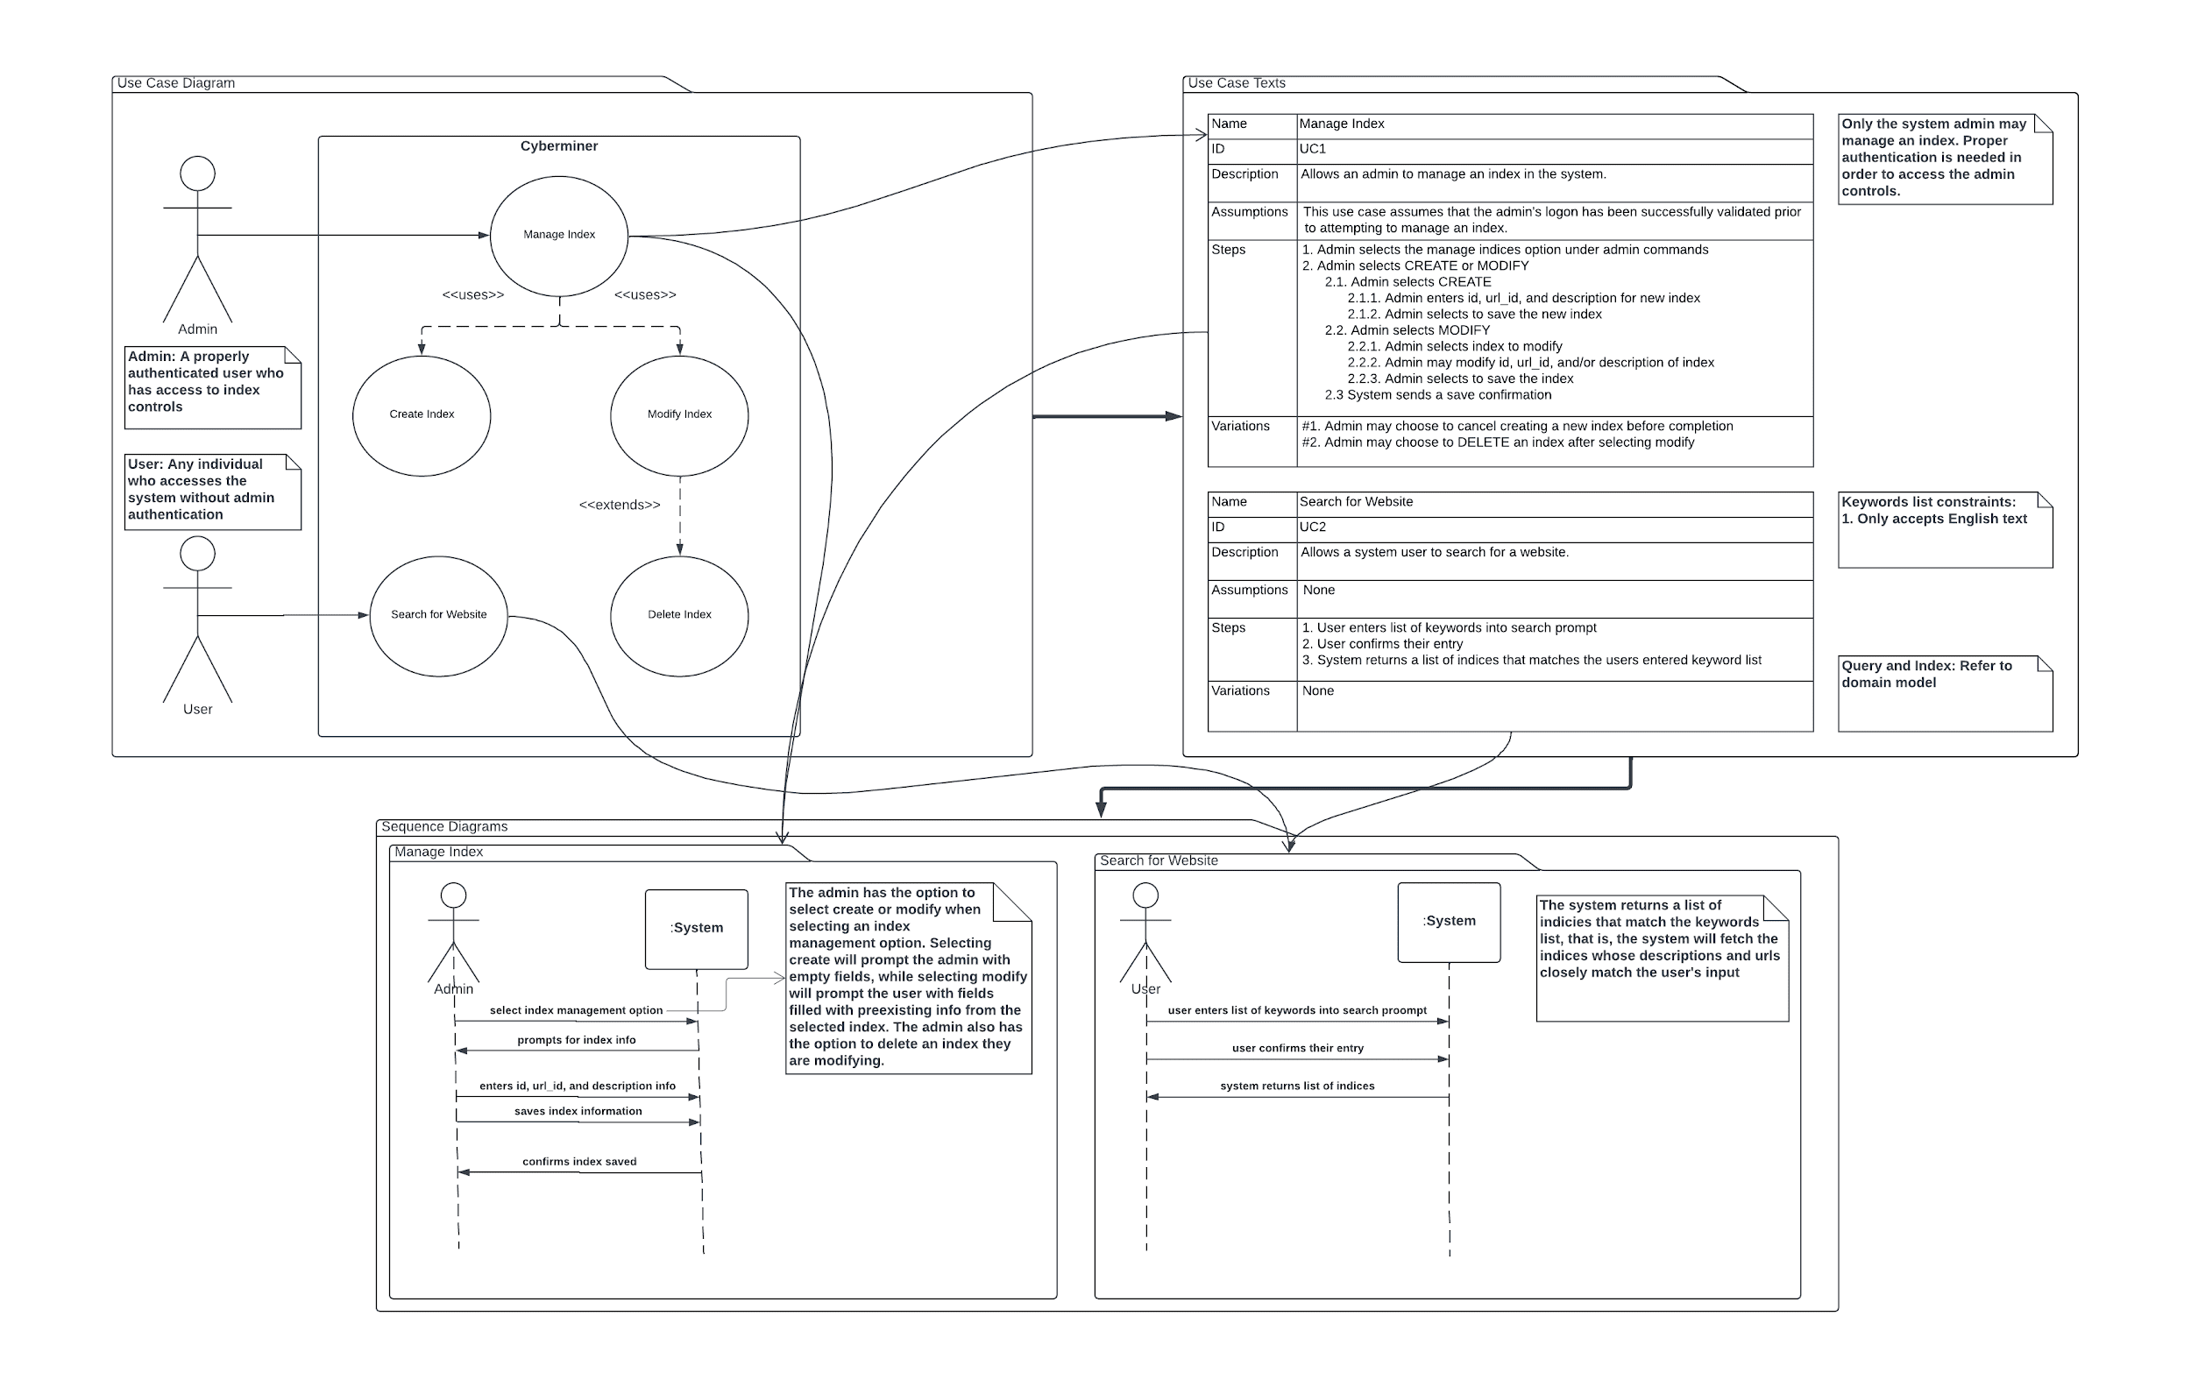
Requirements

Slide 6
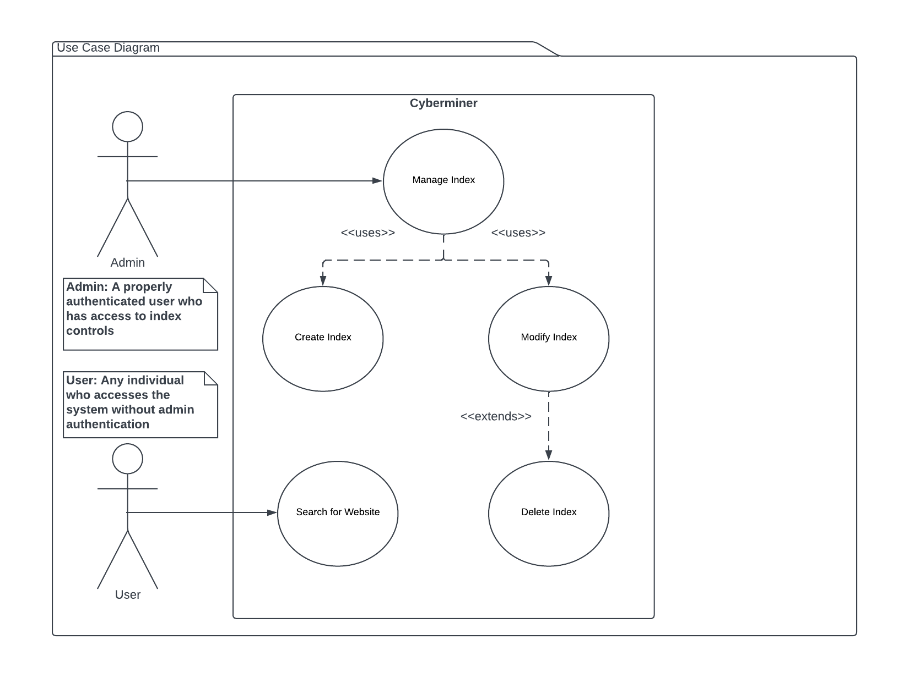
Use Cases

Slide 7
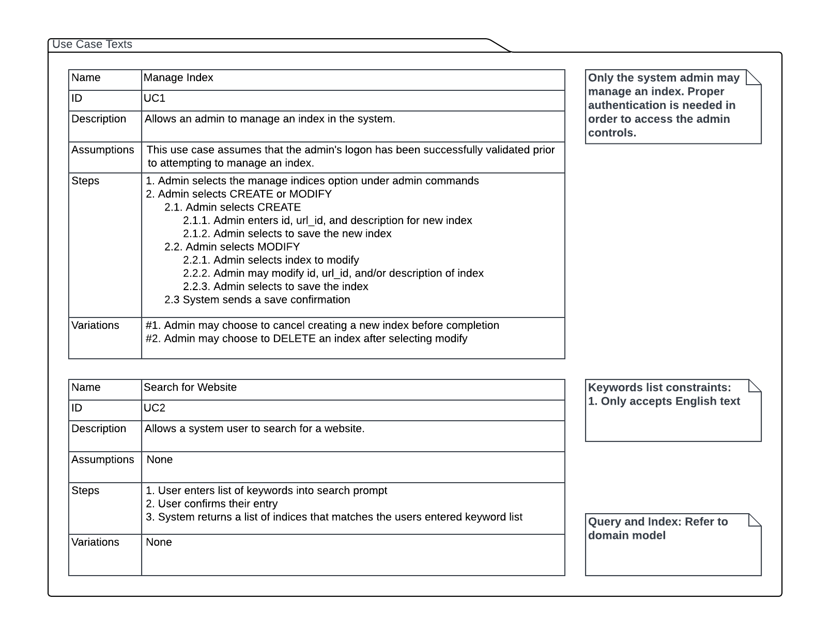
Use Cases Cont.

Slide 8
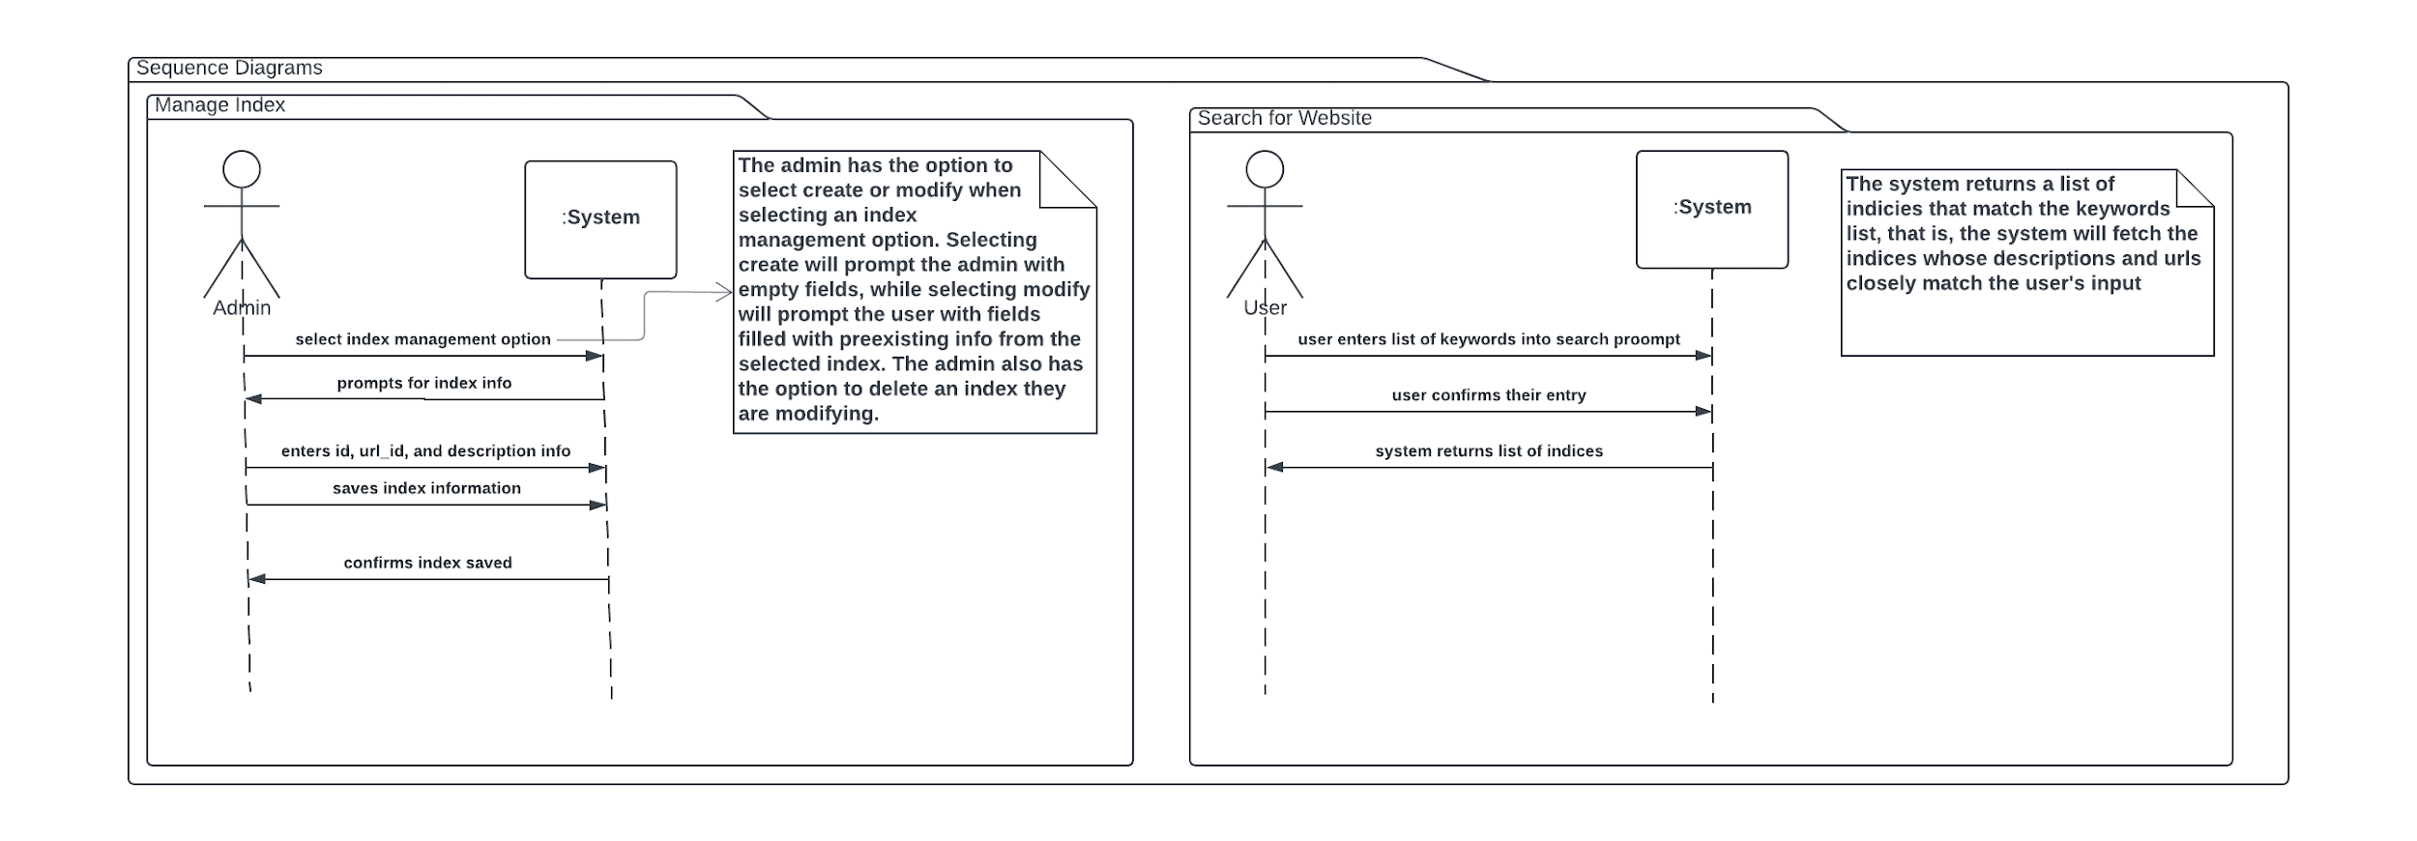
System Sequence Diagrams

Slide 9
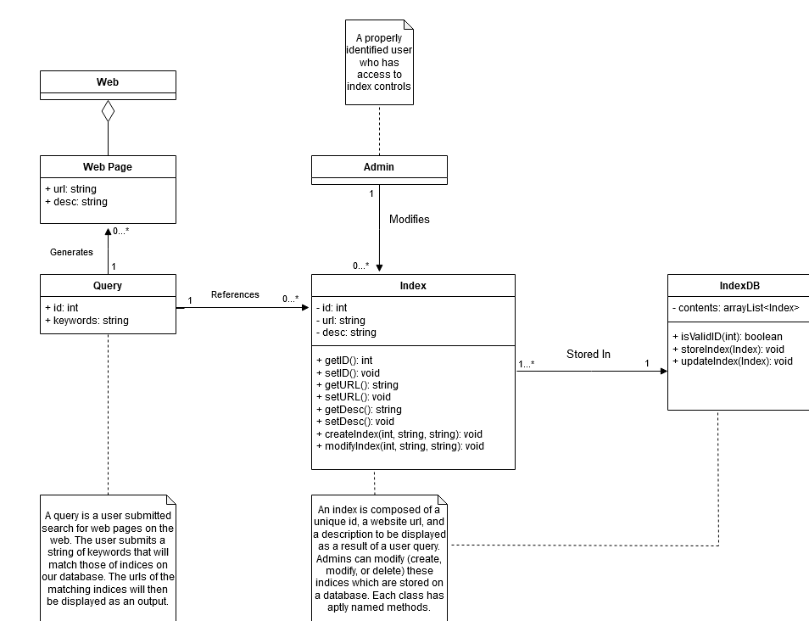
Design Model

Slide 10
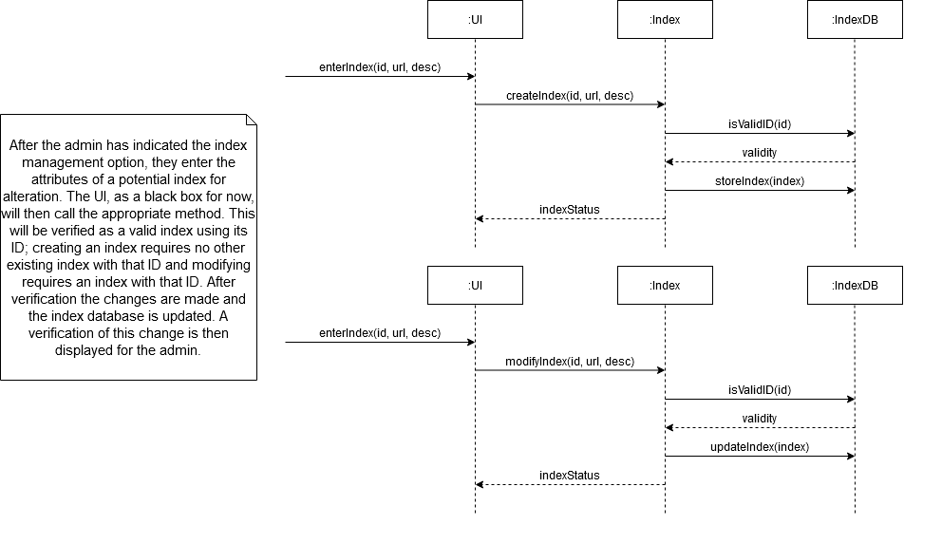
Design Model

Slide 11
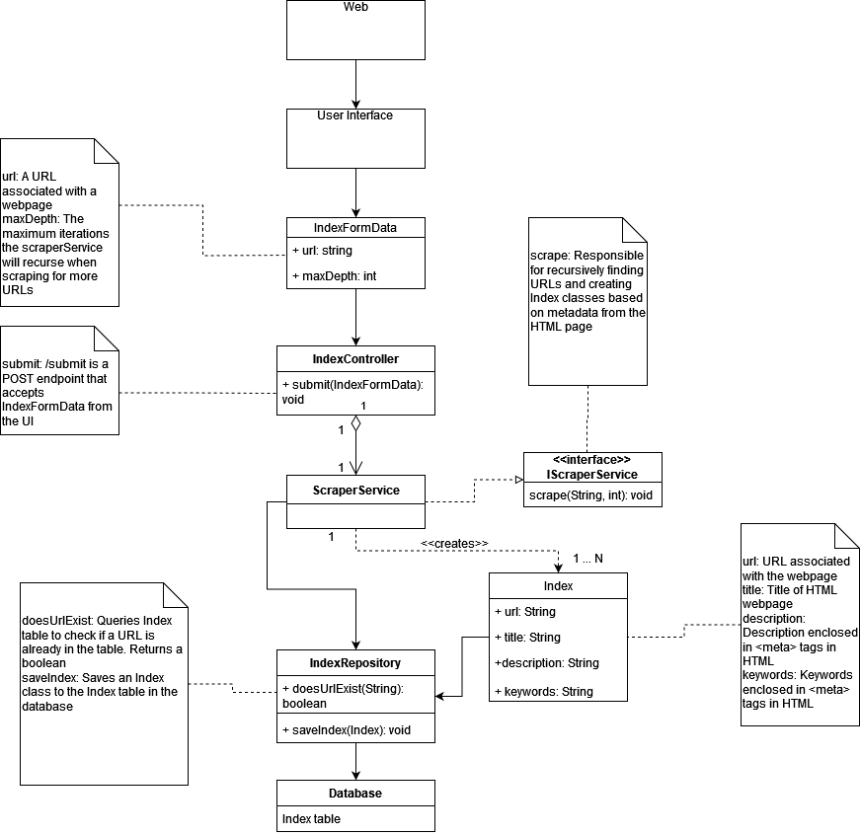
Implementation

Slide 12
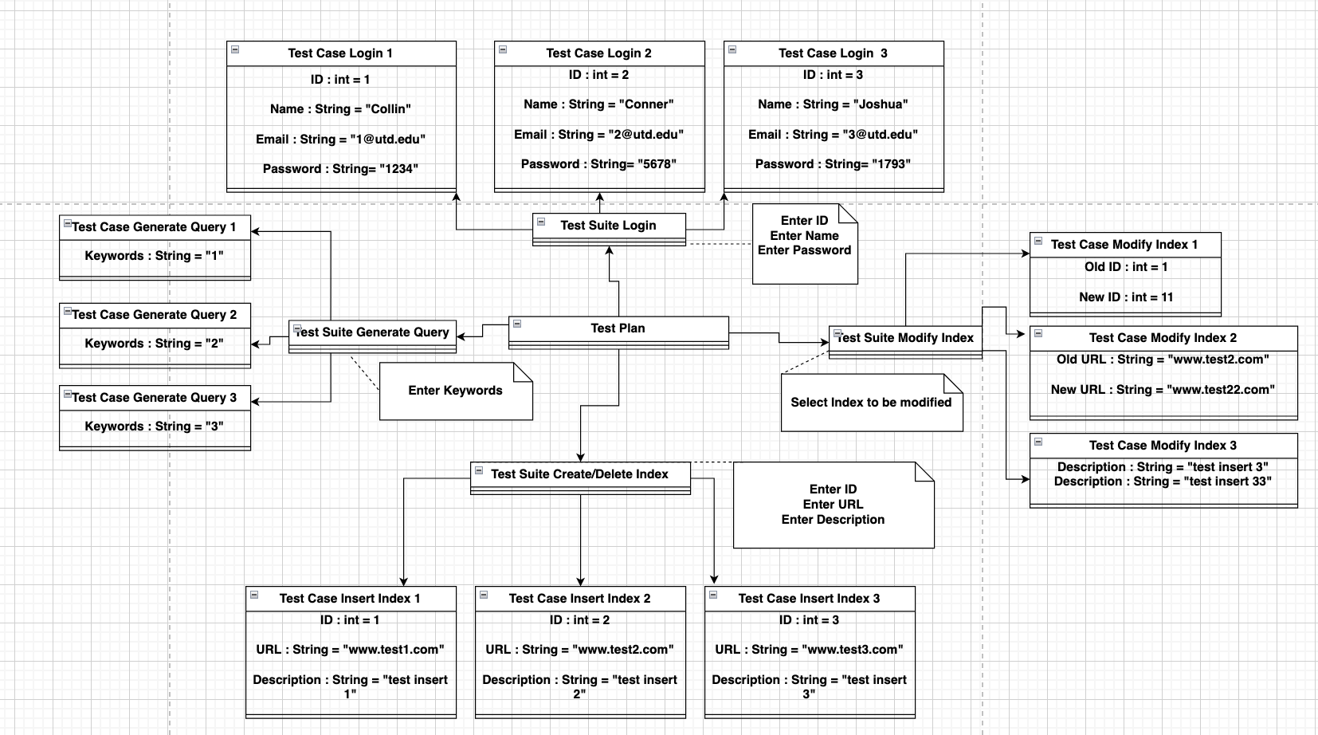
Testing

Slide 13
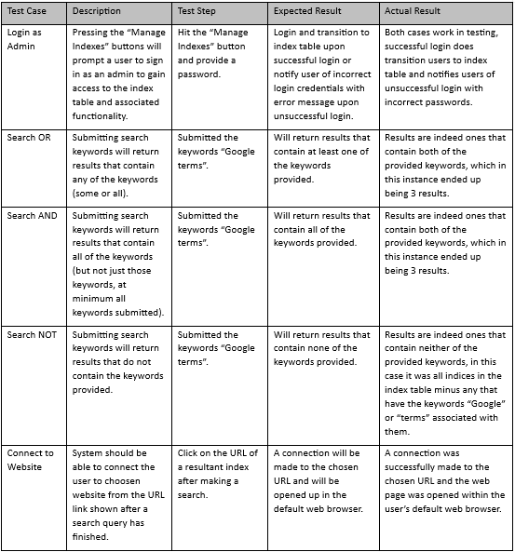
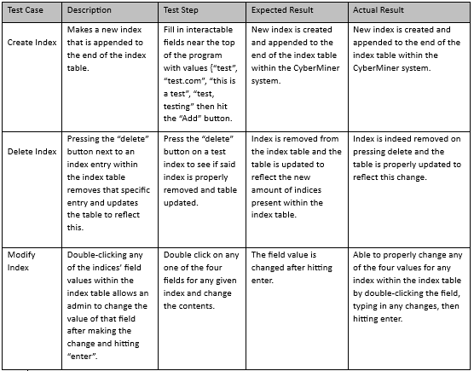
Test Cases with Results

